Slide 1



CRYPTO
SECURITY
DO AND
DON’Ts
Benjamin Nitschke • Feb 2019 Bitcoin Meetup Hannover

Slide 2
Let’s go through the top 10 security tips

Slide 3
Use safe passwords, make them long and hard

Slide 4
2. Protect your data

Slide 5
3. Protect your hardware

Slide 6
4. Keep your software up-to-date

Slide 7
5. Backup everything, all the time. One copy is never enough

Slide 8
6. Limit access, no one should know your secrets unless required

Slide 9
7. Use two-factor authentication

Slide 10
8. Don’t trust anyone

Slide 11
9. Don’t become complacent

Slide 12
10. Don’t just rely on safe programs (Antivirus, VPN, proxies, tor, etc.) properly understand and use them!

Slide 13
With all this in mind, how can anything go wrong?
Pretty much all of these have been experienced by me already this year, wtf!
Or they have been in the news this year .. some of these are hard hitting.

Slide 14
Use safe passwords, make them long and hard
Even if you didn’t do anything wrong, passwords are leaked all the time (551 million passwords leaked and counting), check your accounts:
https://haveibeenpwned.com/Passwords
If you reused your password (and pretty much anyone does), you are even in bigger trouble.

Slide 15
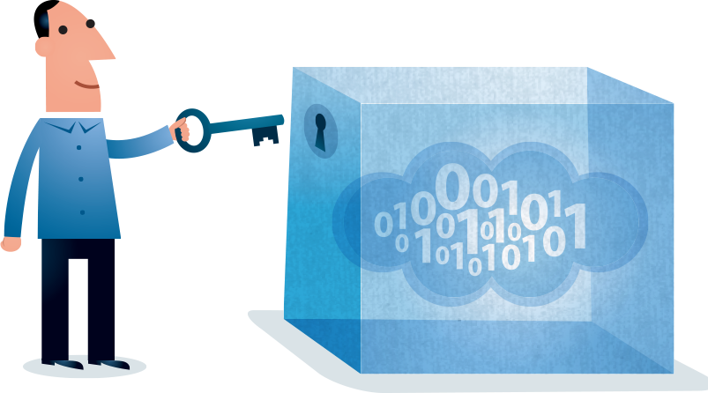
2. Protect your data
Easier said than done, most of the time you don’t even have a choice and your data is leaked by a third party or faulty software you use.

Slide 16
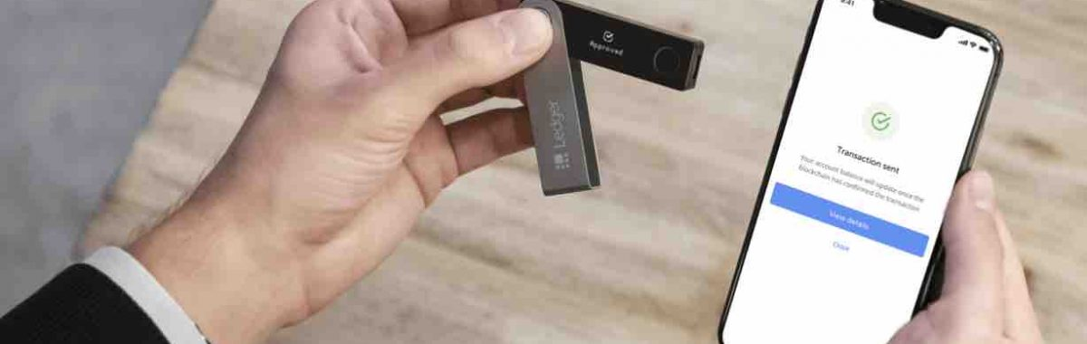
3. Protect your hardware
If your hardware wallet or paper wallet, or your computer, laptop or sever get lost, stolen or just is damaged or broken (fire, water, electrical, etc.), you are still screwed, no matter how safe it all was when it still worked. You need backups!

Slide 17
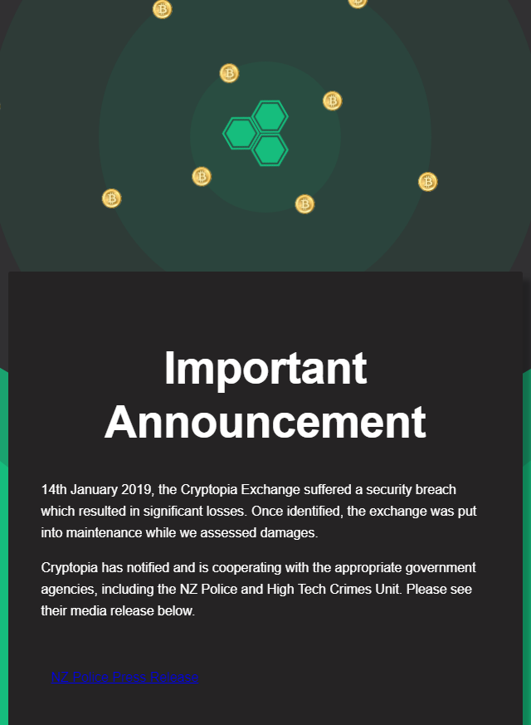
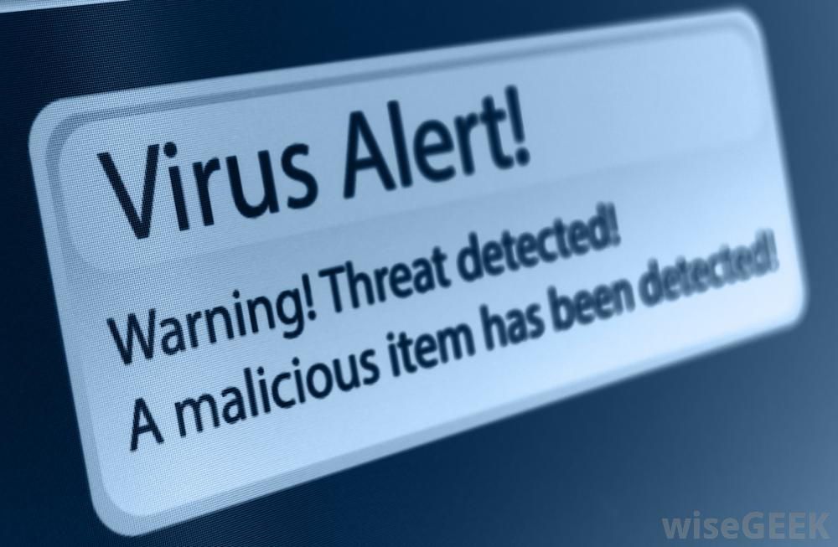
4. Keep Software up-to-date
So you want to have the latest and greatest, all your OS, wallets and software needs to be up to date? Not so fast, new updates can contain new problems and viruses, github accounts can be compromised!

Slide 18
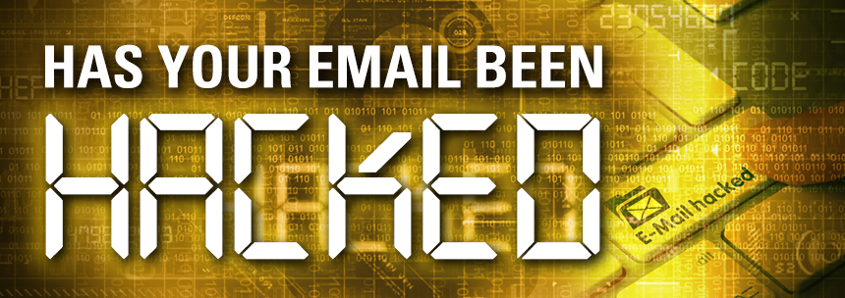
5. Backup everything, all the time. One copy is never enough
Much easier said than done. Who has access to backups? Do you backup into the cloud? What if your backups get hacked?
Email providers got hacked and deleted+all backups gone this year
DropBox was hacked and compromised in the past
Google Drive can be read
Microsoft OneDrive?
etc.
Maybe use encrypted services and emails like Protonmail don’t lose your keys!

Slide 19

6. Limit access, no one should know your secrets
Canadian exchange QuadrigaCX founder died in India. Cold wallet access was only known by him, no way to access any funds, 150-500 million $ lost!
What happens to your money when you are gone? Or what happens if you forget or lose your private keys like so many have in the past (many coins have never moved in the past years).

Slide 20
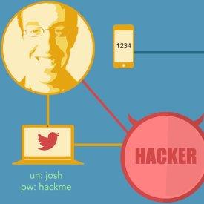
7. Use two-factor authentication
This is one of the best tips in this list, you are pretty much ALWAYS better off using 2FA, but know it still can be hacked!
Your phone can be cloned
Your provider is stupid and might give out your personal data and phone numbers to hackers
The service you might be using might not even work correctly

Slide 21

8. Don’t trust anyone
This isn’t a solution for most people. Kids need to trust their parents, most people believe what they read and hear. Even if you are paranoid, most are not and this lifestyle won’t be easy ...

Slide 22

9. Don’t become complacent
This is the number one reason security fails. Reasons might be laziness, not knowing (aka being stupid) or simple lack of time.
Once you notice you have been complacent it is almost always too late and you will have to spend MUCH MORE time cleaning up ..

Slide 23
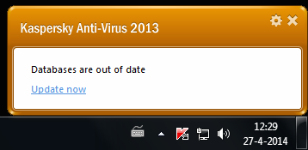
10. Don’t just rely on safe programs (Antivirus, VPN, etc.)
Not only do most users do not understand security implications, many things can be just unsafe by simple misuse: - Antivirus won’t help you if you have a legitimate program exposing you - VPN doesn’t help if you post with your known name or can be tracked - tor is only useful if your browser behavior doesn’t lead back to you
Even if you do everything correctly a simple update of a program, tool or library might break your whole security: - Meltdown, Spectre (intel, all cpus affected) - npm libraries hacked (leaking private keys) - Github developer accounts hacked ..

Slide 24

Stay Safe!
Questions?

